Slide 1
Lesson 10 – Homework review

Slide 2

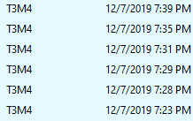
Be yourself

Slide 3
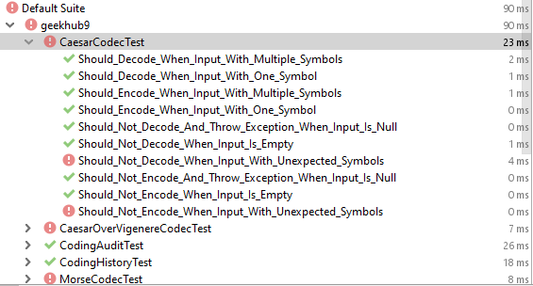
All unit tests should pass after every commit

Slide 4
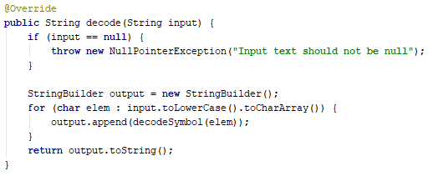

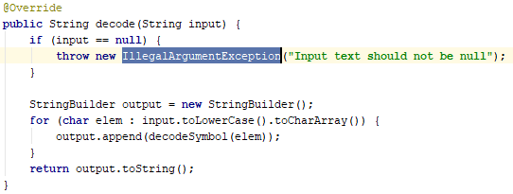
Avoid inline method termination

Slide 5



Avoid reassignments

Slide 6


Inefficient map value fetch

Slide 7



Static fields should be immutable

Slide 8
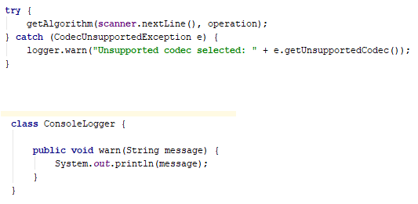

Introduce logger abstraction

Slide 9


Propagate exceptions

Slide 10
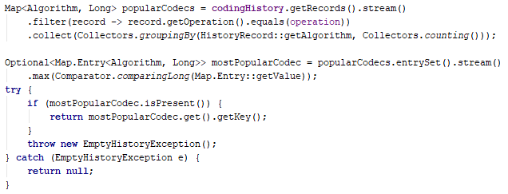

Propagate exceptions

Slide 11
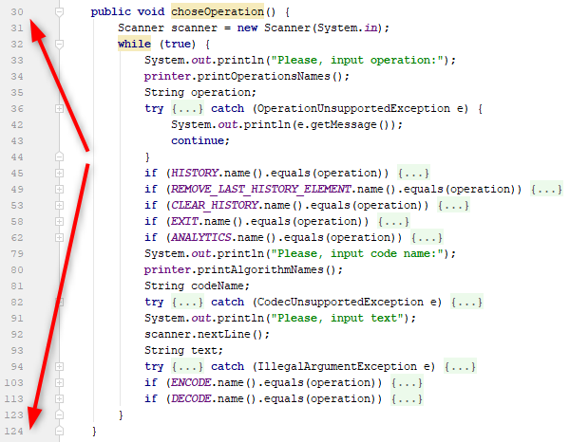
Decouple code

Slide 12
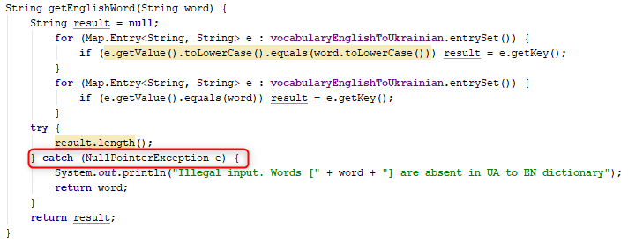
Never catch NullPoinetExcetion

Slide 13
Apply recommendations from personal feedbacks before starting next homework

